Slide 1

Sportconstraint Learning using Tensor Data
Tom De Bièvre

Slide 2

Context
Many real world problems require constraints
Sport scheduling is really complex and laboursome
  2 leagues
  Each league consists of 3 divisions
  162 games per team per regular season
Could this be automated to lower the amount of work?
DTAI, Department of Computer science

Slide 3
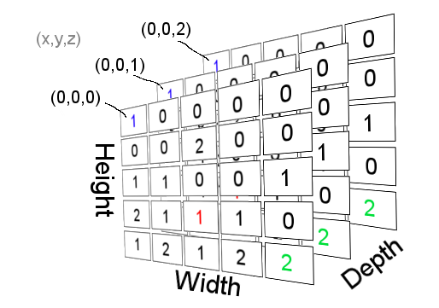
Aim
Constraint programming to make scheduling easier
  Learning/acquiring constraints using tensor manipulation
  Make schedule problems easier
    Particular interest in sports!
DTAI, Department of Computer science

Slide 4

Approach: Literature study
Different kinds sport schedules? Terminology?
  X-Round Robin
Cost functions
Sport scheduling hard / soft constraints?(Nurmi et al.)
Previous work on sport scheduling?
  Traveling tournament problem
  Modelseeker
DTAI, Department of Computer science

Slide 5
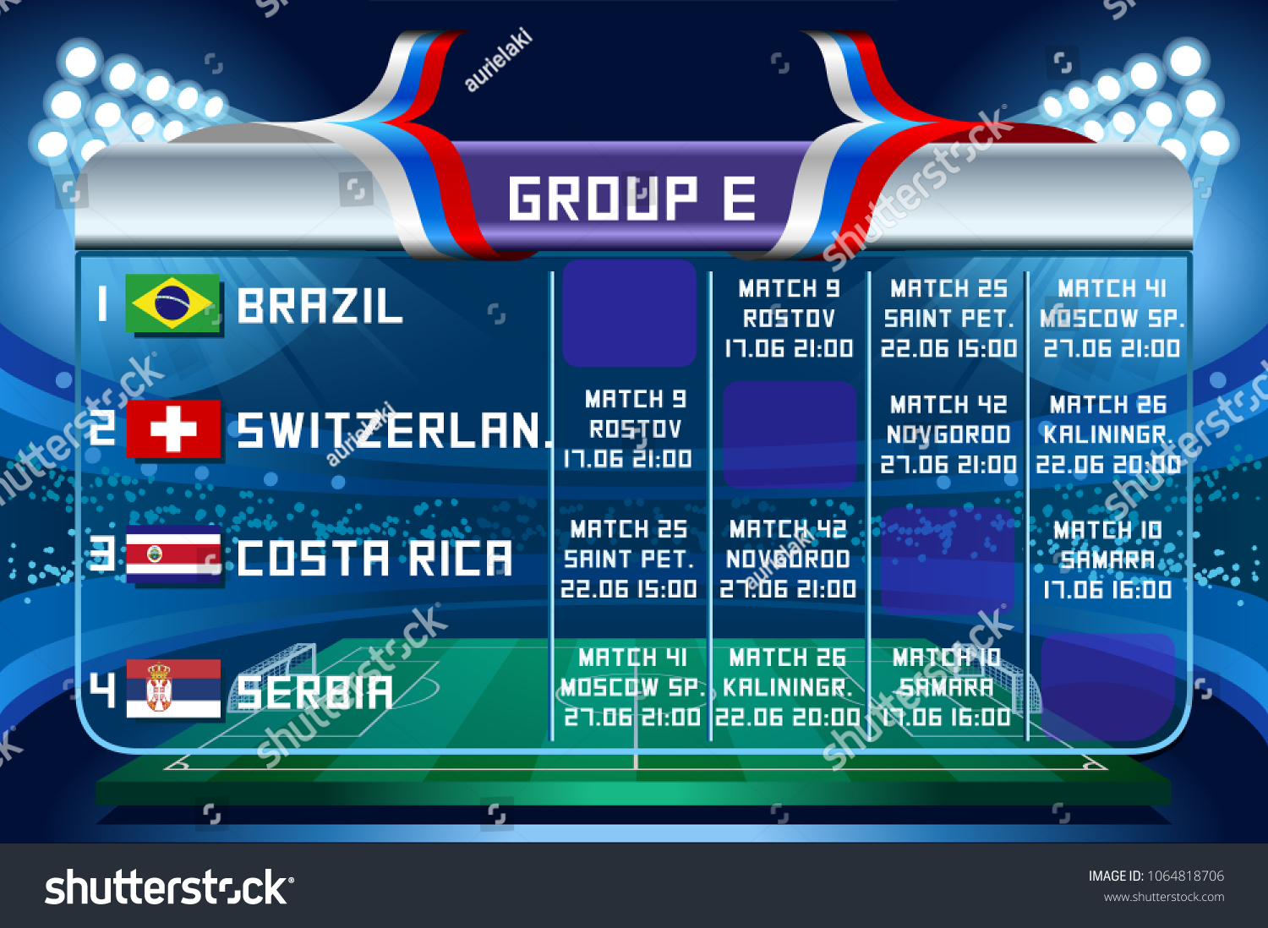
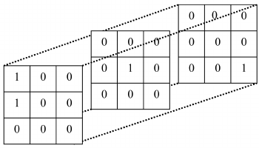
Approach: Research Questions
To what extent could CountOR learn sportconstraints as is?
Could we adapt/generify CountOR to CountSPORT to learn scheduling constraints?
  To what extend can we acquire all constraints?
Could we integrate minimizing/maximizing cost functions into CountSPORT?
DTAI, Department of Computer science

Slide 6
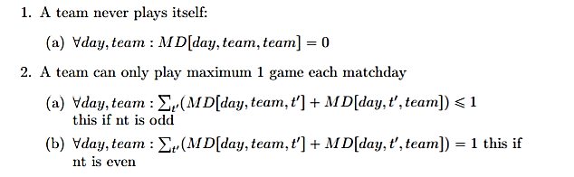
Practical approach: CountOR(benchmark)
Generate set of schedules using own constraints
Hard Constraints
DTAI, Department of Computer science

Slide 7
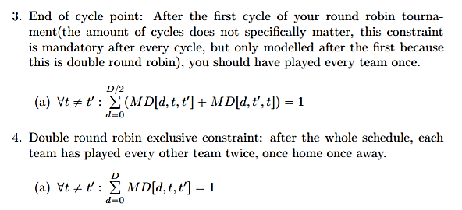
Practical approach: CountOR(benchmark)
DTAI, Department of Computer science

Slide 8
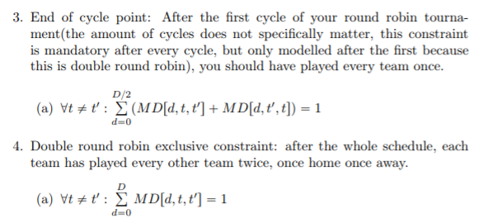
Practical approach: CountOR(benchmark)
Learn with CountOR as is
  Generate new set schedules using acquired constraints
  Satisfy?
DTAI, Department of Computer science

Slide 9

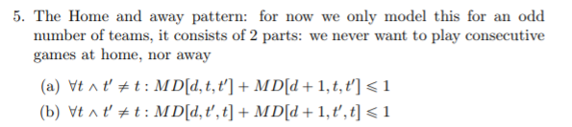
Practical approach: CountSPORT
Adapt CountOR
  Hard constraints
  Soft constraints?

Slide 10


Putting it to work: a practical use case
Scheduling the Belgium football competition (format used since 2009)
  16 teams: 30 games in regular competition
  Playoff 1: Division of 6 teams
  Playoff 2: 2 divisions of 4 teams
  Playoff 3: 1 division of 2 teams
Lots of edge cases
DTAI, Department of Computer science

